Slide 1
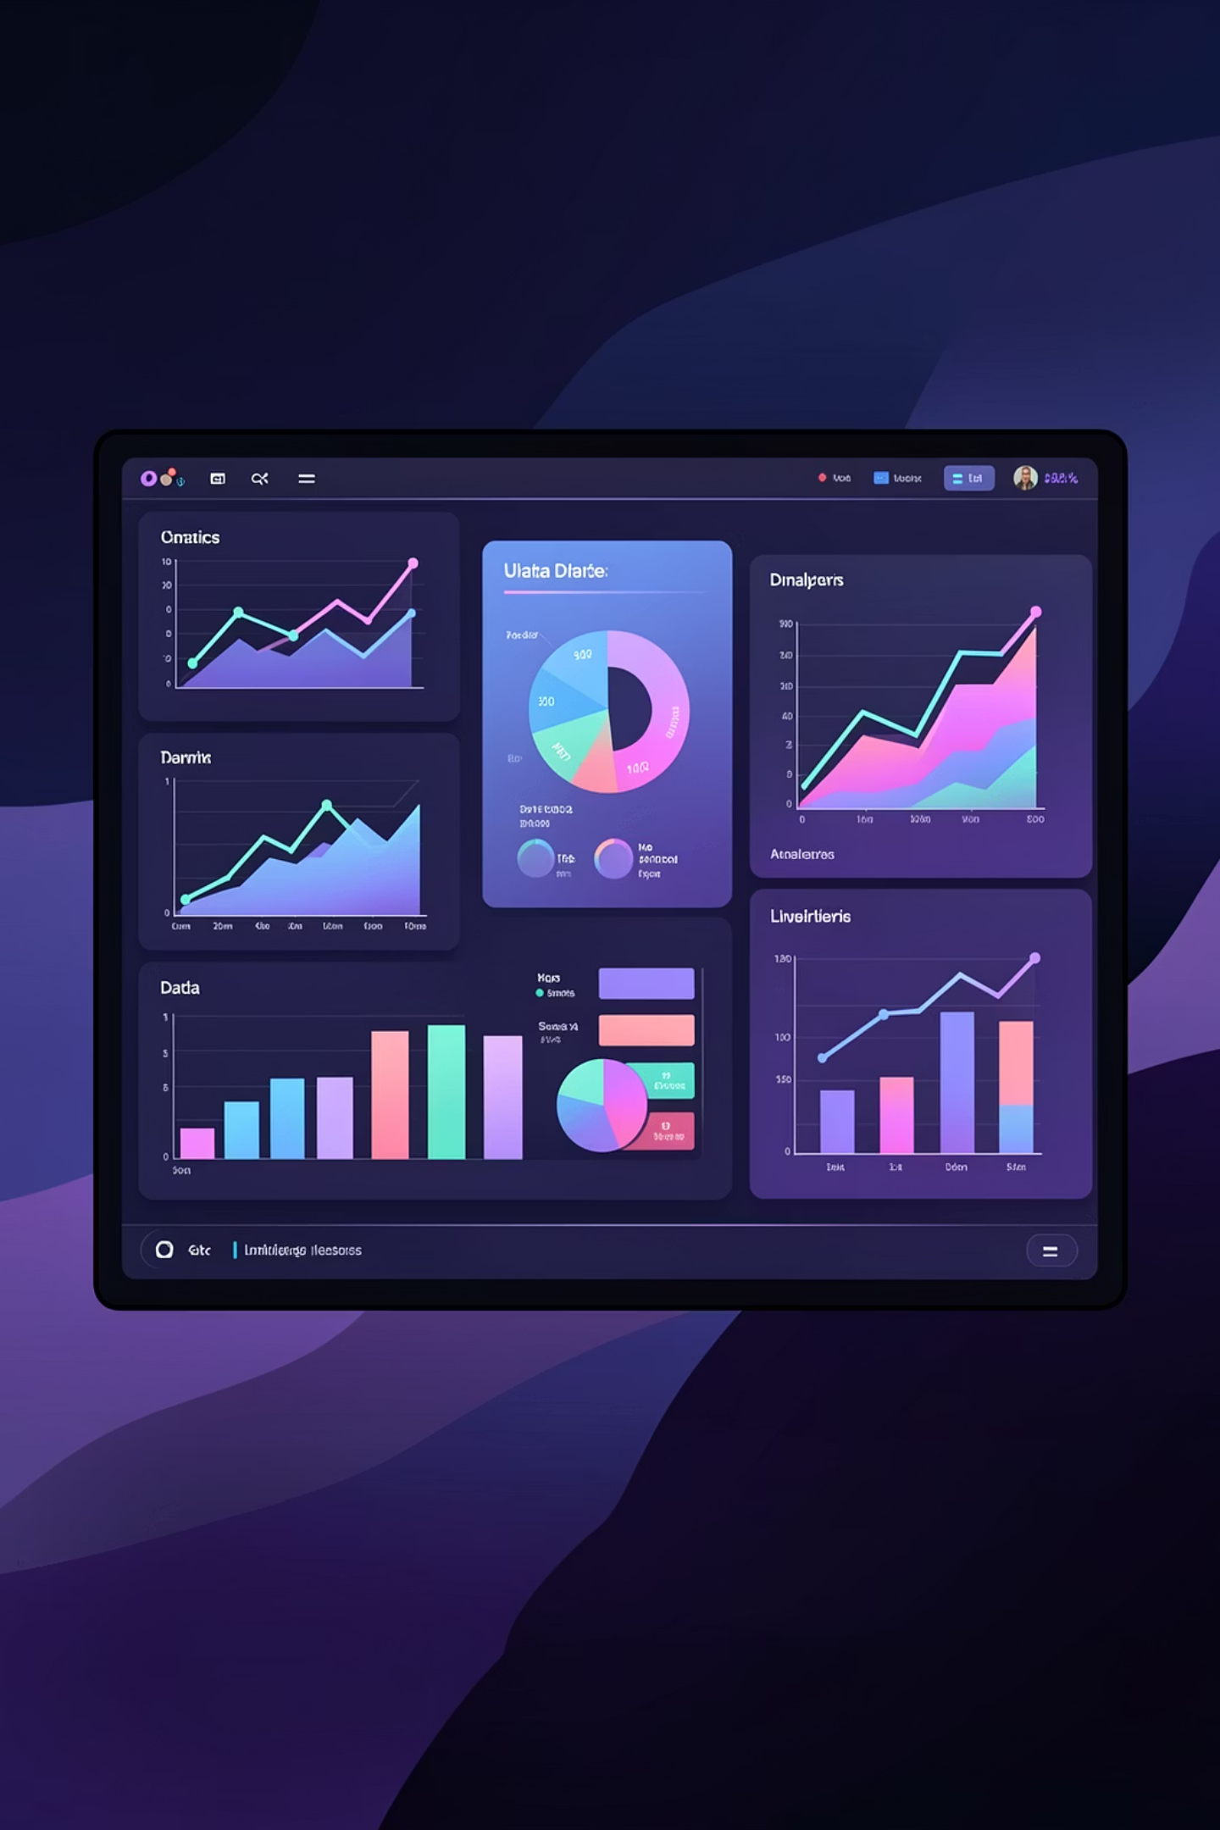
Customer Shopping Behavior Analysis
Uncovering insights from 3,900 purchases to drive strategic decisions

Slide 2
DATASET OVERVIEW
The Foundation
3.9K
18
50
Total Purchases
Data Points
Locations
Transactions analyzed
Features per customer
Geographic coverage
Key Features Tracked
Customer demographics & subscription status
Purchase details & product categories
Shopping behavior & review ratings
Shipping preferences & payment methods

Slide 3

PHASE 1
Data Preparation in Python
01
Load & Explore
Imported dataset, checked structure and summary statistics
02
Clean & Standardize
Handled 37 missing values, renamed columns to snake_case
03
Engineer Features
Created age_group and purchase_frequency_days columns
04
Database Integration
Connected to PostgreSQL for advanced SQL analysis

Slide 4

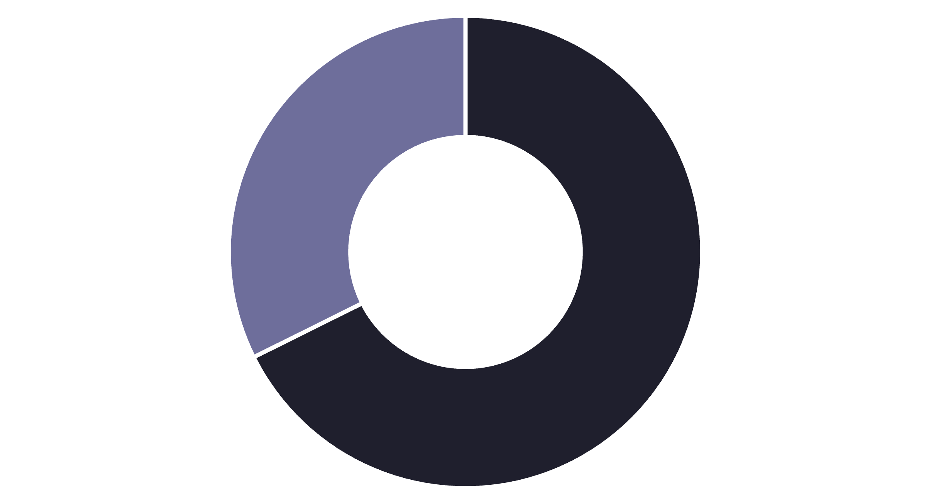
SQL ANALYSIS
Revenue Insights by Gender
Male
Female
Male Customers Drive Revenue
Male shoppers generate 68% of total revenue despite representing 68% of customer base
$158K
$75K
Male Revenue
Female Revenue

Slide 5


Top Performing Products
Highest Rated Items
3.86
3.84
3.82
Gloves
Sandals
Boots
3.80
3.78
Hat
Skirt
Average ratings out of 5.0 stars

Slide 6
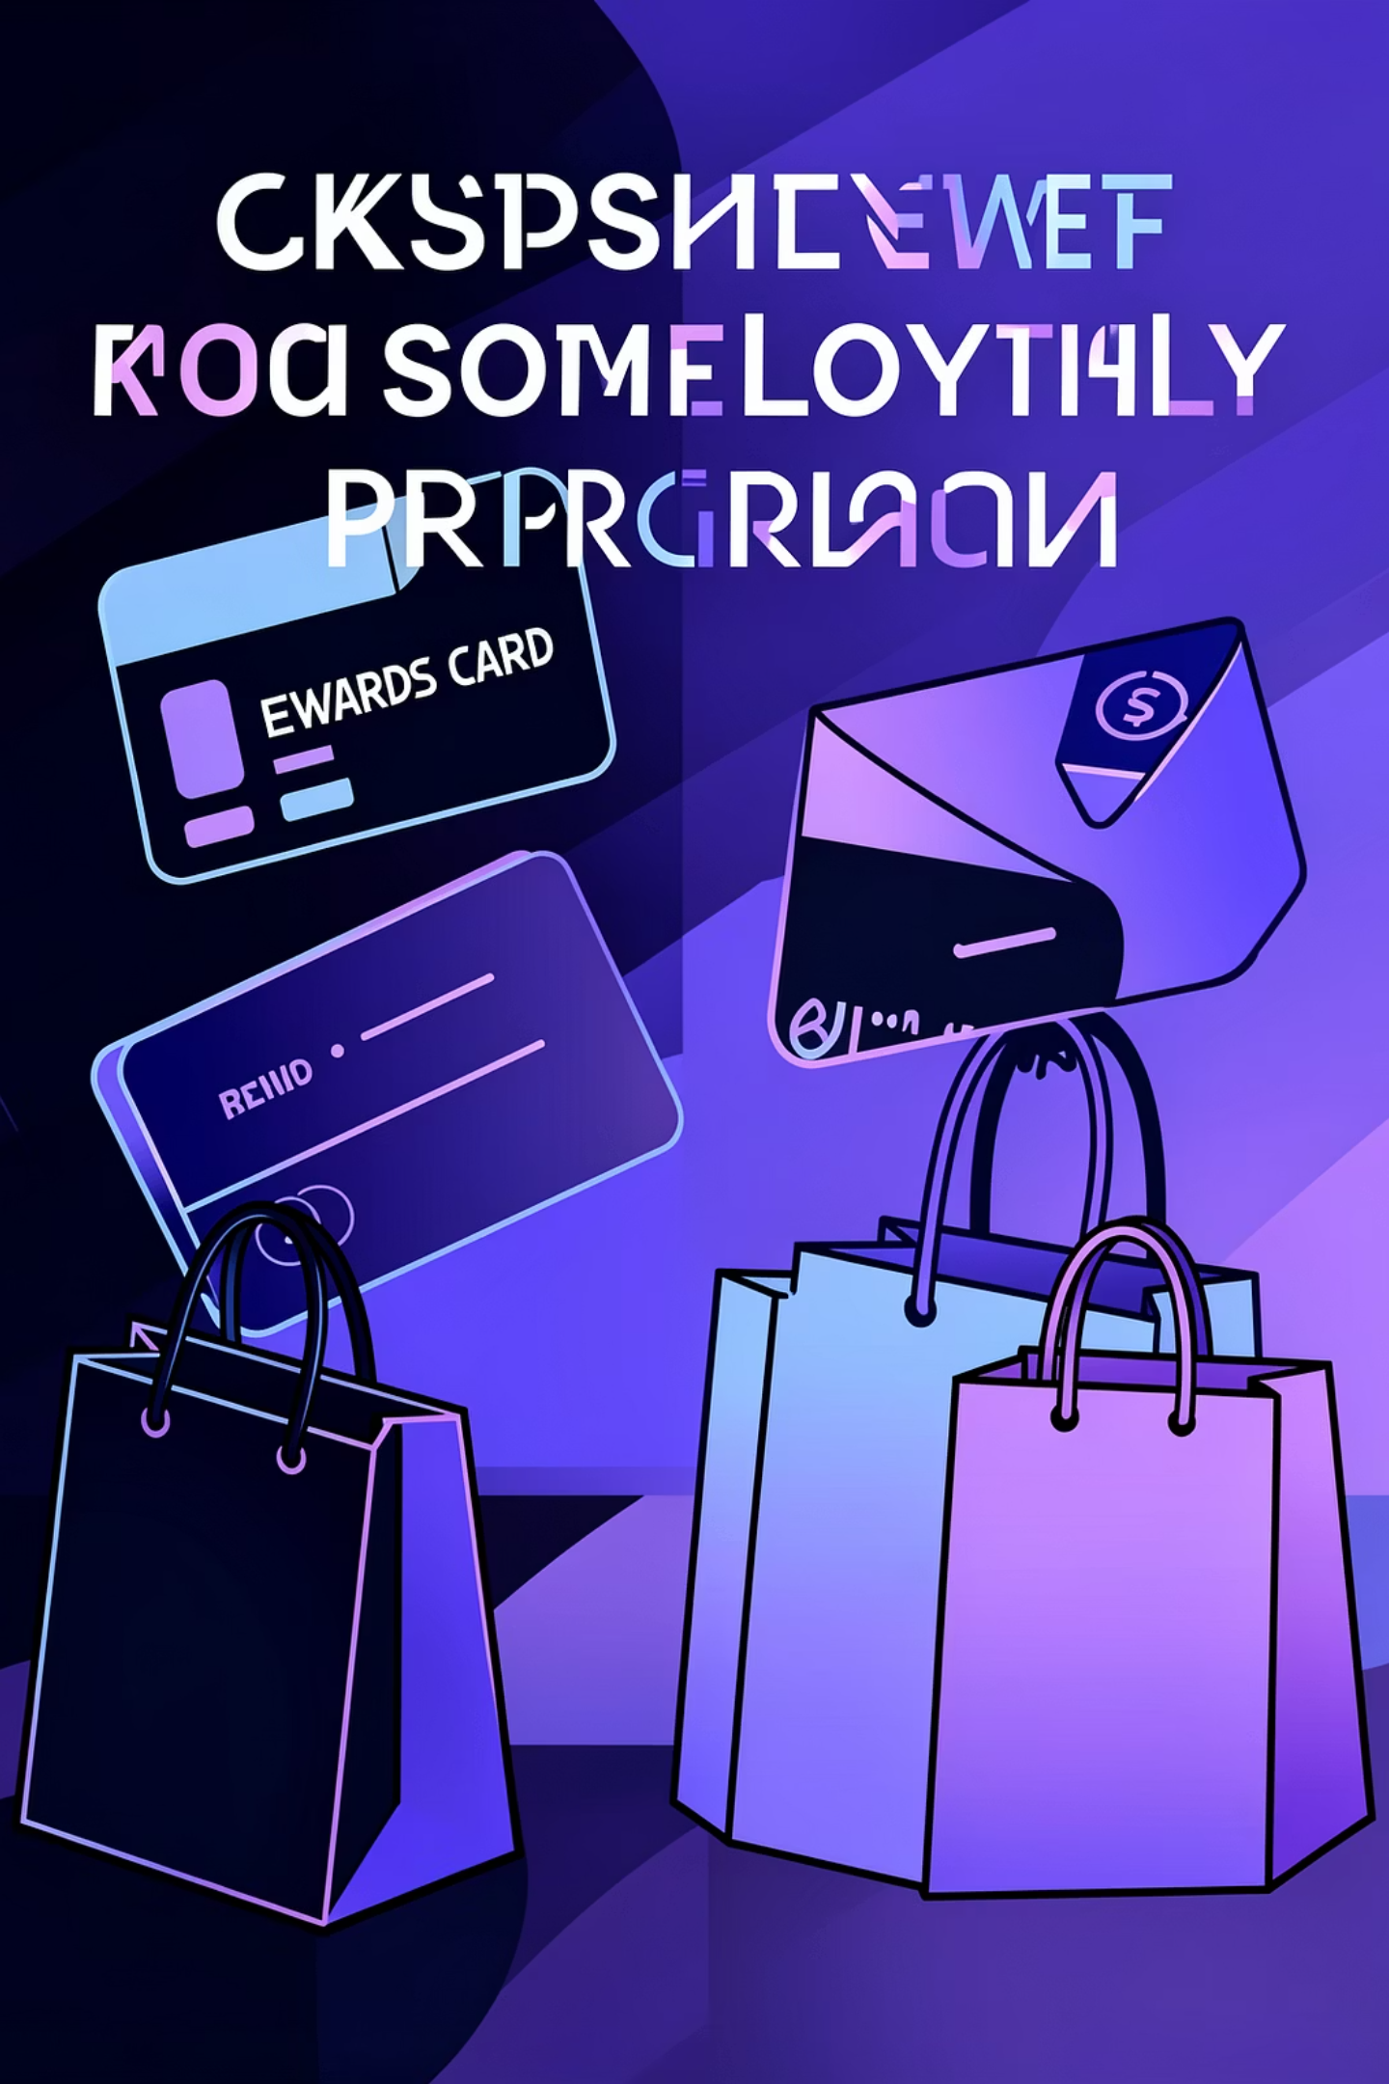
Customer Segmentation
Loyal Customers
Returning Buyers
3,116 customers
701 customers
80% of customer base with 5+ purchases
18% making 2-4 repeat purchases
New Shoppers
83 customers
2% first-time buyers to convert

Slide 7
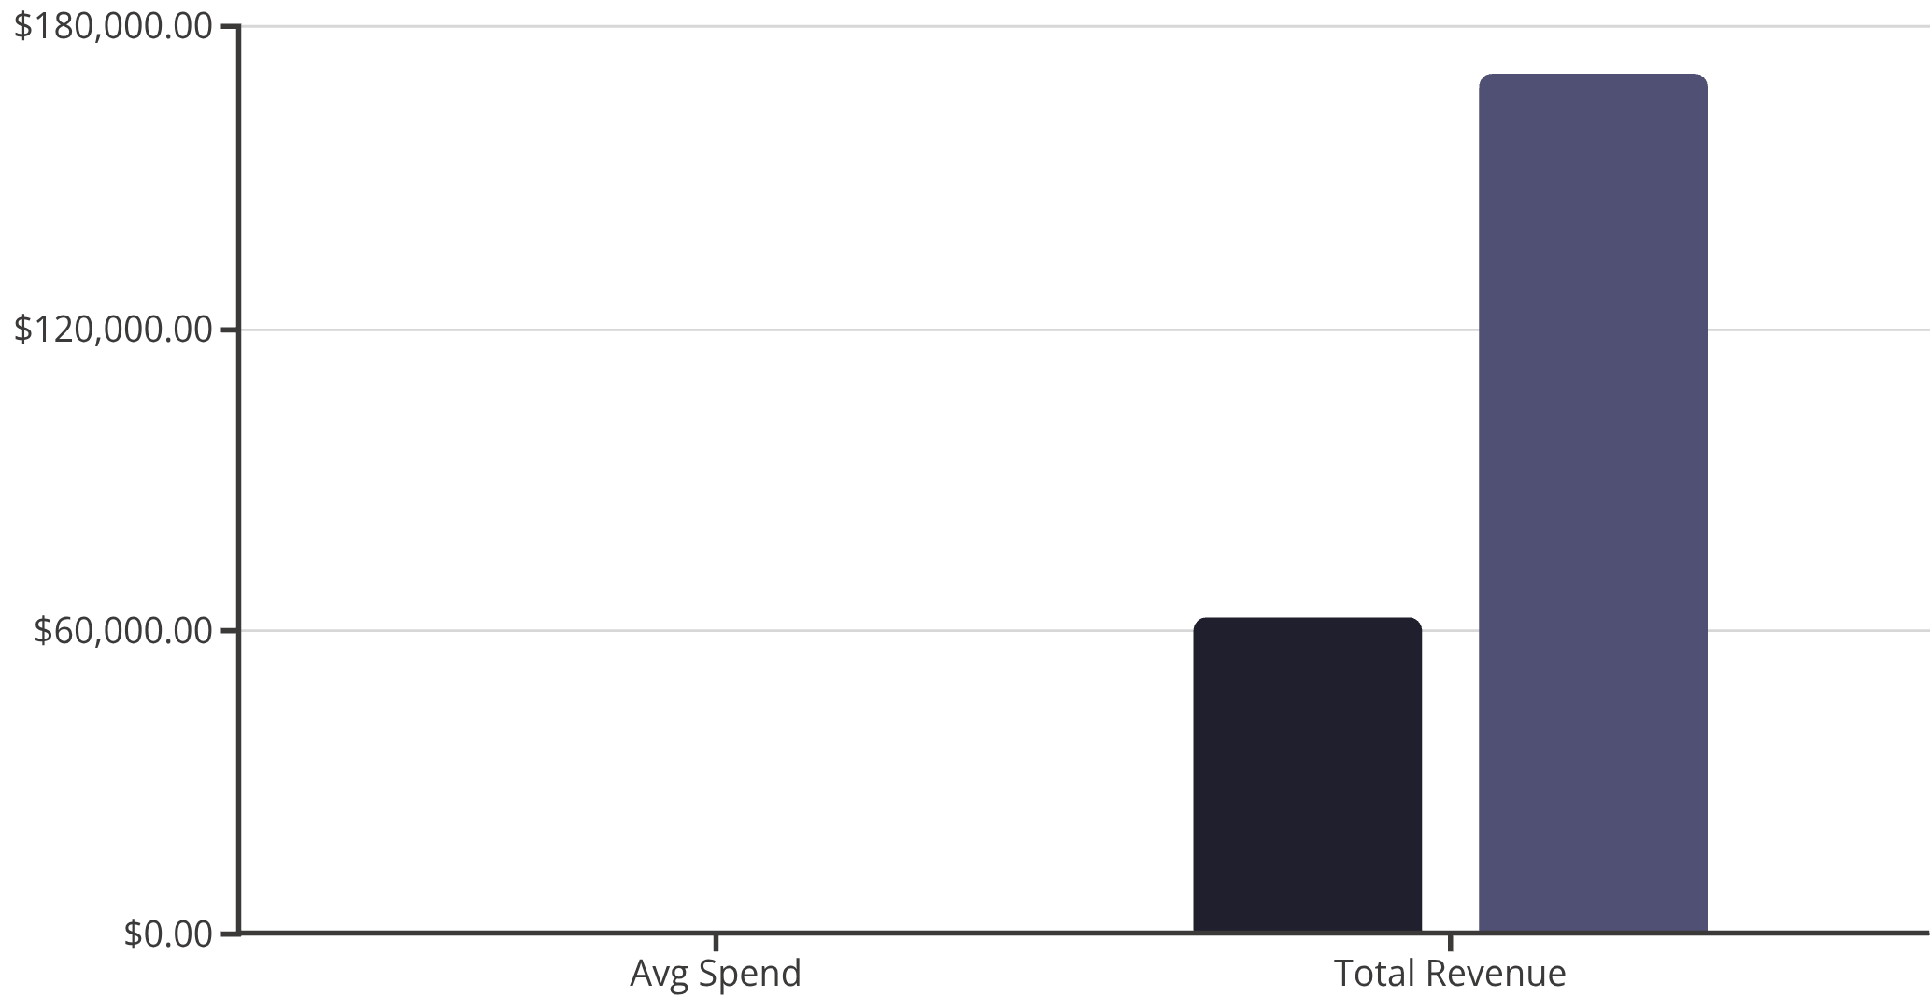
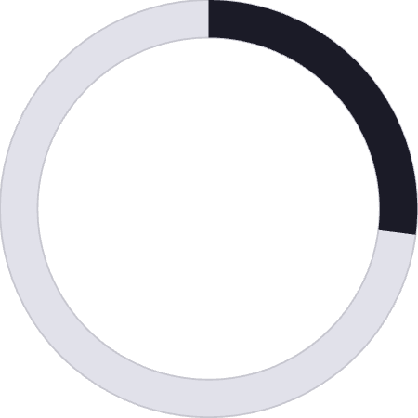
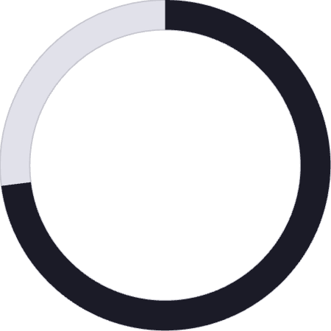
SUBSCRIPTION ANALYSIS
Subscriber vs Non-Subscriber Behavior
Subscribers
Non-Subscribers
Key Findings
27%
73%
Customers with subscriptions
Non-subscribers dominate revenue
Similar spending patterns but massive untapped subscription potential

Slide 8
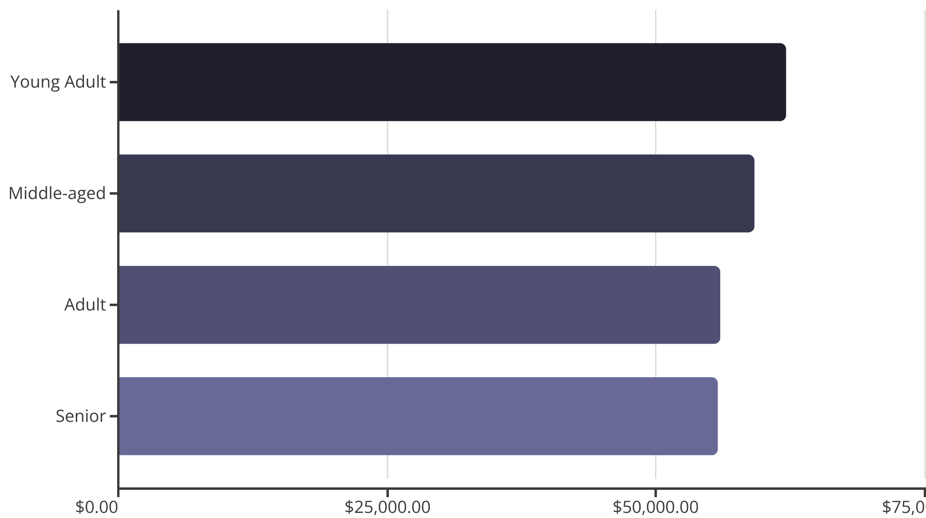
Revenue Distribution by Age
Young Adults Lead
Highest revenue segment with balanced distribution across all age groups
Target marketing to young adults while maintaining broad appeal

Slide 9


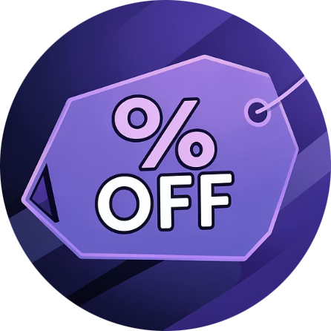


STRATEGIC INSIGHTS
Business Recommendations
Boost Subscriptions
Loyalty Programs
Optimize Discounts
Product Focus
Promote exclusive benefits to convert 73% non-subscribers
Reward repeat buyers to grow loyal segment beyond 80%
Balance sales boosts with margin control for profitability
Highlight top-rated items like gloves and sandals in campaigns
Targeted Marketing
Focus on high-revenue young adults and express shipping users

Slide 10
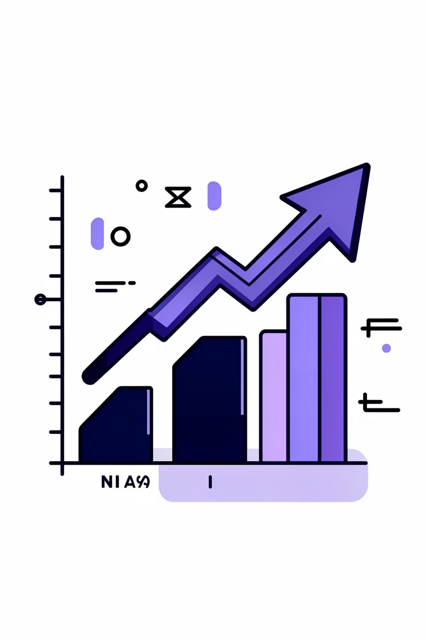




Next Steps
Implement Loyalty Program
Launch within Q1 to capture repeat buyers
Test Subscription Incentives
A/B test exclusive benefits to boost 27% rate
Monitor & Optimize
Track KPIs and refine strategies quarterly
Ready to transform insights into action. Contact the analytics team to discuss implementation timelines and resource allocation.

